Slide 1
Thursday, August 30, 2012
T.I.S.K. Problems
Evaluate: $\frac{4}{5}+\frac{2}{3}$
Find the constant difference and tell which difference is constant in the sequence: -50, -12, 2, 4, 6, 20, 58, …
Evaluate: $3−{(9−5)}^{2}$
We will have 3 Mental Math Questions today.
Homework: 2.7 Worksheet
Notes:
Mental Math
Start with a multiple of 7 between 40 and 50. Add 63. Divide by 4. (28)
Start with a multiple of 8 between 50 and 60. Add 28. Divide by 4. (21)
Start with a multiple of 9 between 60 and 70. Add 29. Divide by 4. (23)

Slide 2
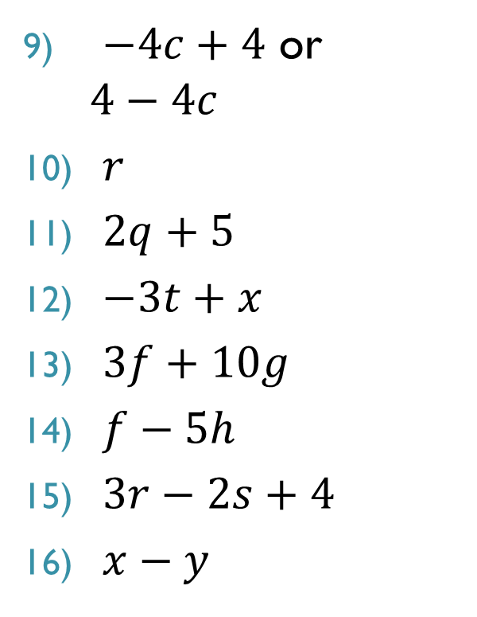

Homework Check
$a$
$10f$
$3r$
$3d$
$2a−1$
$4mp$
$3b$
$12p−3q$
$−4c+4$ or $4−4c$
$r$
$2q+5$
$−3t+x$
$3f+10g$
$f−5h$
$3r−2s+4$
$x−y$

Slide 3




§2.7 Dividing Expressions
What is division?
Multiplication by a reciprocal
What does that mean?
$54÷9=$
$108÷6=$
$8÷32=$
$21÷6=$
$\frac{3}{5}÷\frac{9}{20}=$
$$\frac{1}{9}$$
$$54∙$$
$$=6$$
$$\frac{1}{6}$$
$$108∙$$
$$=18$$
$$\frac{1}{32}$$
$$8∙$$
$$=\frac{1}{4}$$
$$\frac{1}{6}$$
$$=\frac{7}{2}$$
$$21∙$$
$$=\frac{4}{3}$$
$$\frac{20}{9}$$
$$\frac{3}{5}∙$$

Slide 4
§2.7 Dividing Expressions
How is that helpful?
$\frac{15x+6}{3}$
We can now write this as $(15x+6)\frac{1}{3}$
Time to use the Distributive Property!
$=\frac{1}{3}\left(15x\right)+\frac{1}{3}\left(6\right)$
$=5x+2$

Slide 5
§2.7 Dividing Expressions
You try it (on your white board):
$\frac{24y+16}{8}$
$\frac{18p−27}{9}$
$\frac{6r−4}{−2}$
$\frac{−8z+8}{−8}$
$$=3y+2$$
$$=2p−3$$
$$=−3r+2$$
$$=z−1$$

Slide 6
§2.7 Dividing Expressions
Now for something a little different…
$\frac{3x^{2}+6x}{x}$
We’ll still use the idea that division is multiplication by a reciprocal.
Therefore this is:
$\frac{1}{x}\left(3x^{2}+6x\right)$
$=\frac{1}{x}\left(3x^{2}\right)+\frac{1}{x}(6x)$
$=3x$
$$\frac{1}{x}∙$$
$$3∙$$
$$x^{2}$$
$$\frac{1}{x}∙$$
$$x^{2}$$
$$∙3$$
$$+6$$
$$=$$
$$\frac{1}{x}∙$$
$$x∙x$$
$$∙3$$
$$=$$
$$=$$
$$x$$
$$∙3$$

Slide 7
§2.7 Dividing Expressions
Your turn. Pick up your white board and try these problems.
$\frac{4{ac}^{2}+3c}{c}$
$\frac{n^{3}+4n^{4}}{n}$
$\frac{2{ab}^{2}+7cb}{b}$
$\frac{24w^{3}+15w}{3w}$
$$=4ac+3$$
$$=n^{2}+4n^{3}$$
$$=2ab+7c$$
$$={8w}^{2}+5$$

Slide 8
Homework
2.7 Worksheet
OPTIONAL: Review Chapter 2 by completing the Chapter test in the book.

